Slide 1

Evaluating Benchmarks for SGD Classifier
Landon Buell
14 Feb 2020

Slide 2
Classification Benchmarks
Confusion Matrix, Precision, Recall, F1 Score

Slide 3
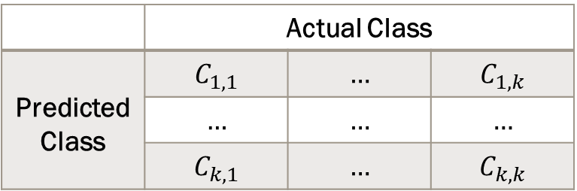
Confusion Matrix
(K x K) matrix for a K-Bins classifier
(Petrik)
Columns are actual values
Rows are predicted values
A Good classifier has a strong main diagonal
 | Actual Class
Predicted Class | $$C_{1,1}$$ | $$…$$ | $$C_{1,k}$$
 | $$…$$ | $$…$$ | $$…$$
 | $$C_{k,1}$$ | $$…$$ | $$C_{k,k}$$

Slide 4

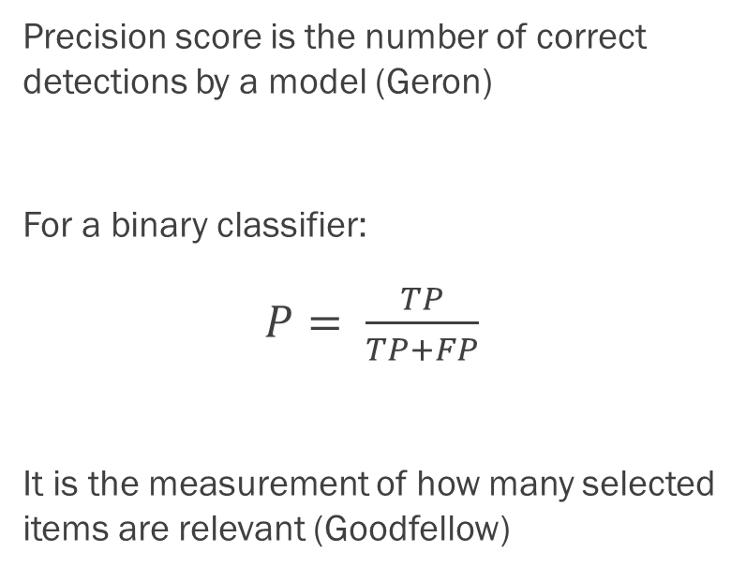
Precision Score
Precision score is the number of correct detections by a model (Geron)
For a binary classifier:
$P= \frac{TP}{TP+FP}$
It is the measurement of how many selected items are relevant (Goodfellow)
For a K-Folds Classifier:
Precision for n-th class:
$P_{n}= \frac{C_{n,n}}{\sum_{i=1}^{k}{C_{i,n}}}$

Slide 5

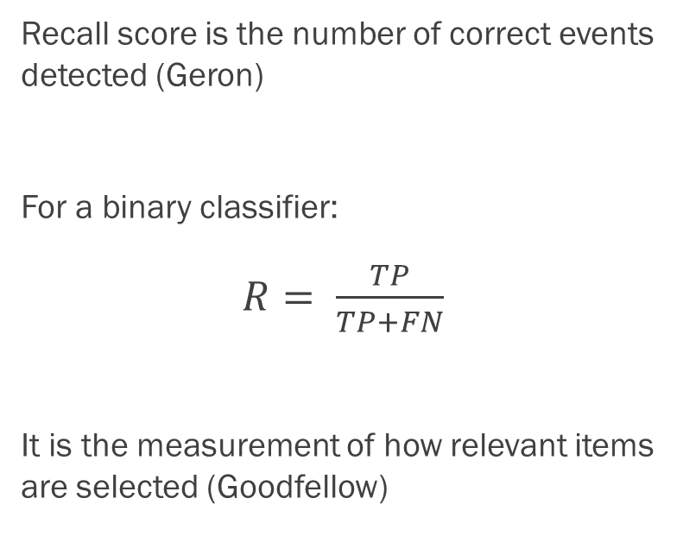
Recall Score
Recall score is the number of correct events detected (Geron)
For a binary classifier:
$R= \frac{TP}{TP+FN}$
It is the measurement of how relevant items are selected (Goodfellow)
For a K-Folds Classifier:
Precision for n-th class:
$P_{n}= \frac{C_{n,n}}{\sum_{i=1}^{k}{C_{n,i}}}$

Slide 6

F1 Score
F1 score is the harmonic mean of precision and recall, bounded on [0,1]
For a binary classifier:
$F1=2\left(\frac{P×R}{P+R }\right)$
It is the measurement of how relevant items are selected (Goodfellow)

Slide 7
Stochastic Gradient Descent Classifier
“The Heart of All Learning Algorithms” (Goodfellow)

Slide 8
SGD Classifier
Basic Linear Model Classifier – very power & very slow
Many algorithms use some variation of this (Goodfellow)
Uses the gradient of a decision function to create an optimal set of parameters for classifier (Sanderson)

Slide 9
MNIST DATA
Collection of 70,000 images of hand-written figures
Arranged into (28 x 28) pixel arrays
For this test, I use the first 10,000 images
Split into 8,000 training figures, 2,000 testing figures
Permutated w/ numpy library to ensure ‘randomness’

Slide 10

Gaussian Noise
Pseudo-Random noise is added to each image – Drawn from Gaussian
$𝒩\left(μ,σ\right)= \frac{1}{\sqrt{2πσ^{2}}}e^{−\frac{{\left(x−μ\right)}^{2}}{2σ^{2}}}$
This is a common approximation for error in regression functions (James)

Slide 11
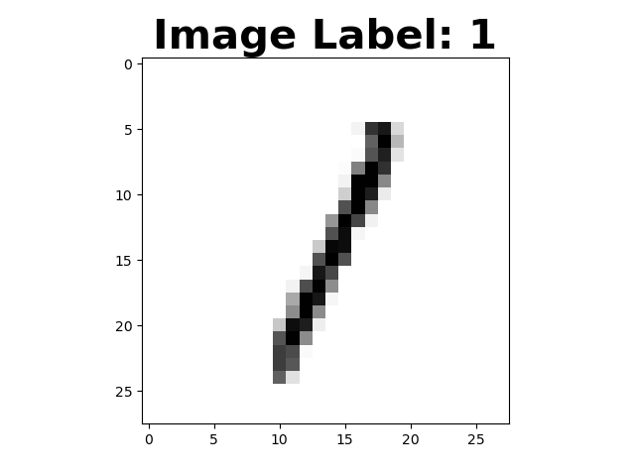
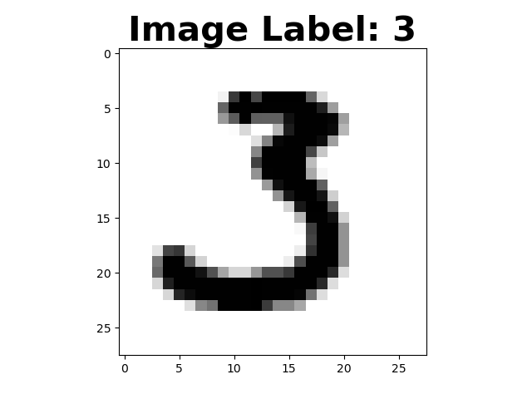
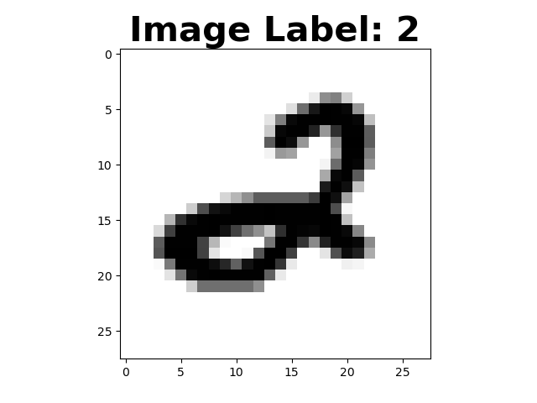
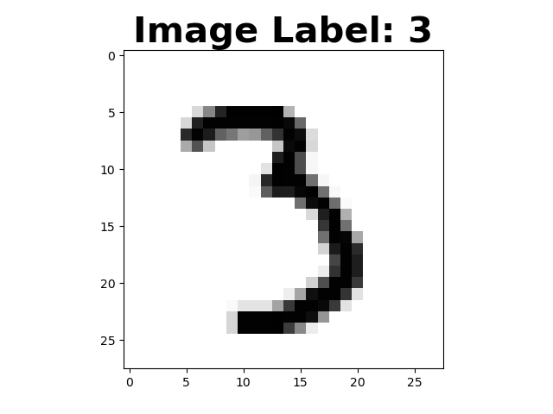
The Control Classifier
Training samples
Testing Samples

Slide 12
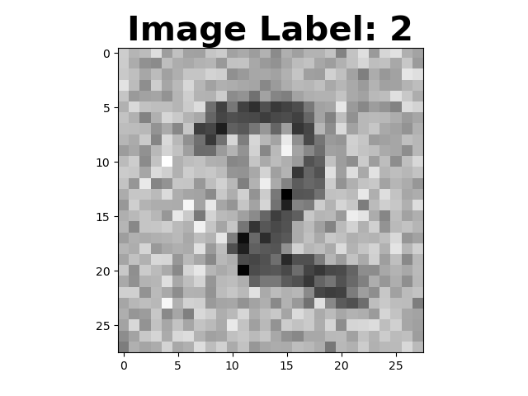
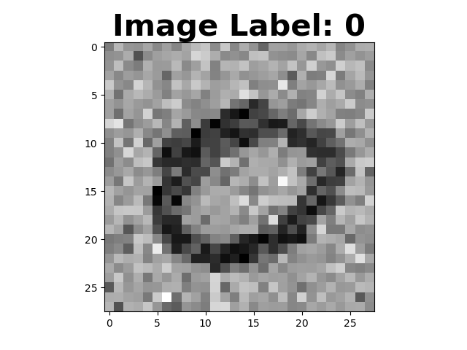
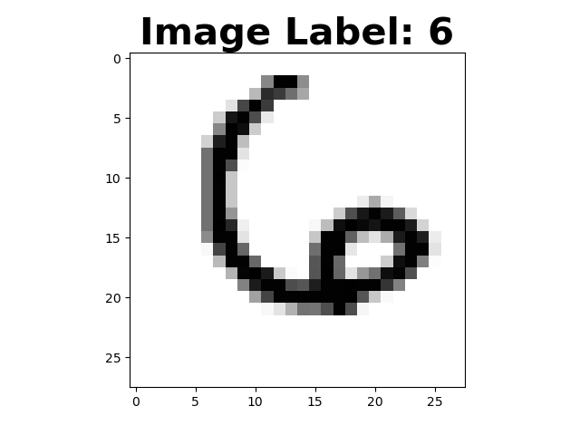
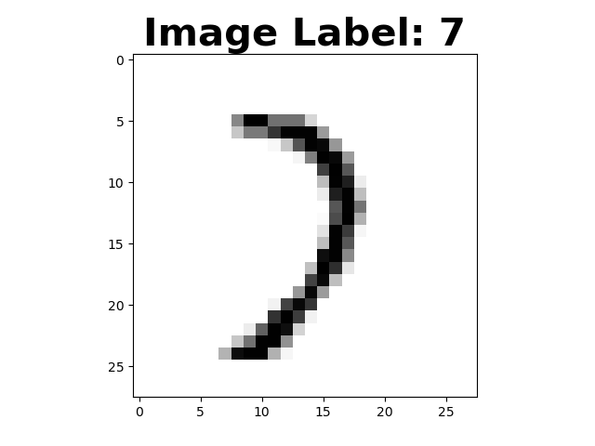
The Noisy – Clean Classifier
Training Samples
Testing Samples

Slide 13
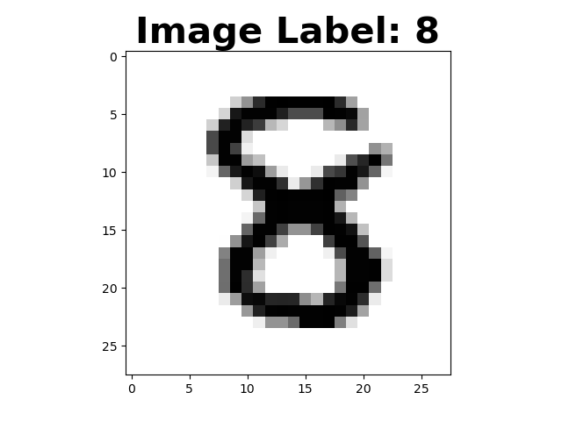
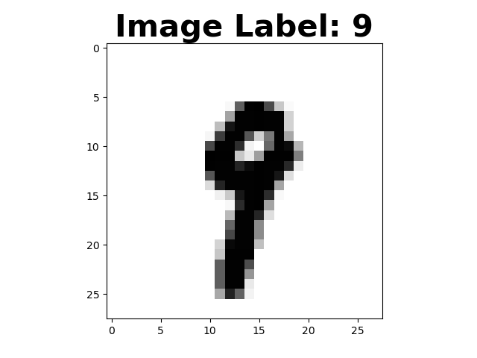
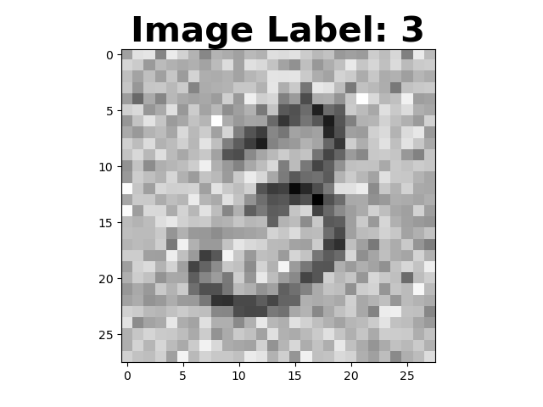
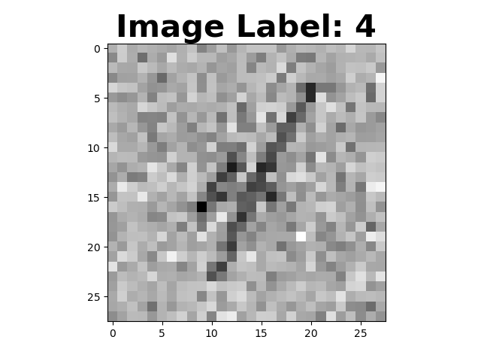
The Clean – Noisy Classifier
Training Samples
Testing Samples

Slide 14
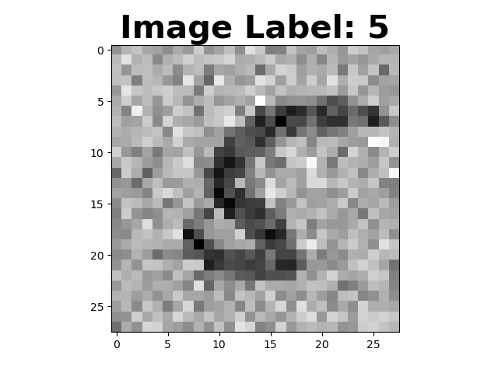
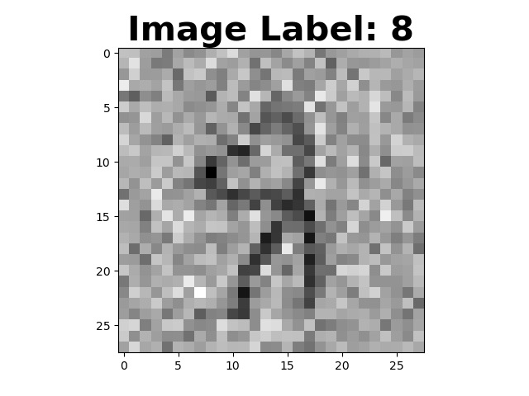
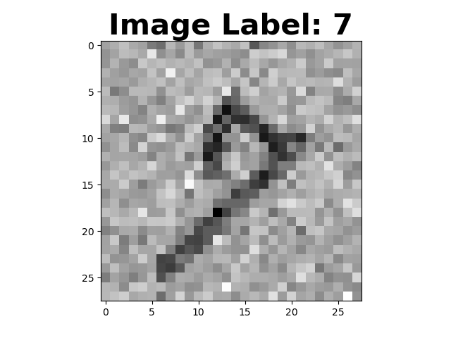
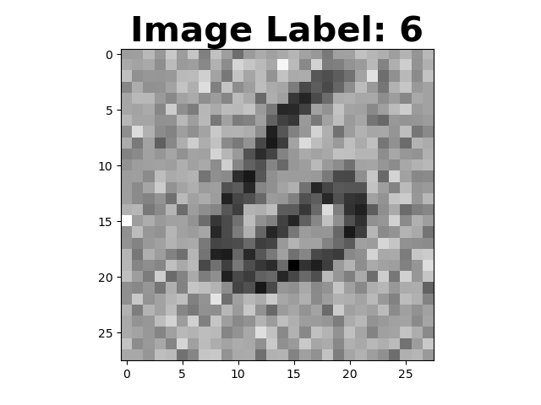
The Noisy Classifier
Training Samples
Testing Samples

Slide 15
Citations
Geron Aurelien. Hands-on Machine Learning with Scikit-Learn and TensorFlow: Concepts, Tools, and Techniques to Build Intelligent Systems. O’Reilly, 2017.
Goodfellow, Ian, et al.Deep Learning. MIT Press, 2017.
James, Gareth, et al. An Introduction to Statistical Learning with Applications in R. Springer, 2017.
Olsen, R.S., et al. 2017. ’PMLB: A Large Benchmarking Suite for Machine Learning Evaluation and Comparison’. Biodata Mining
Petrik, Marek. “Introduction to Machine Learning.” Machine Learning. 05 Feb. 2020, Durham, New Hampshire
Sanderson, Grant. But What Is A Neural Network? 3Blue1Brown, www.3blue1brown.com/neural-networks.

